Slide 1
Buildings built in minutes - Structure from Motion (SfM)
Jonathan L Crespo
Gaurav Upadhyay
Naga Kambhampati

Slide 2
Content
Introduction
Algorithm
Pipeline
Results
Improvements
Future Work
Conclusion

Slide 3
Introduction
. Structure from Motion (SfM) is the process of estimating the 3-D structure of a scene from a set of 2-D views [1].
The following presentation is a summary of the attempt to implement the technique, simulation of different cases, challenges faced and conclusions.

Slide 4
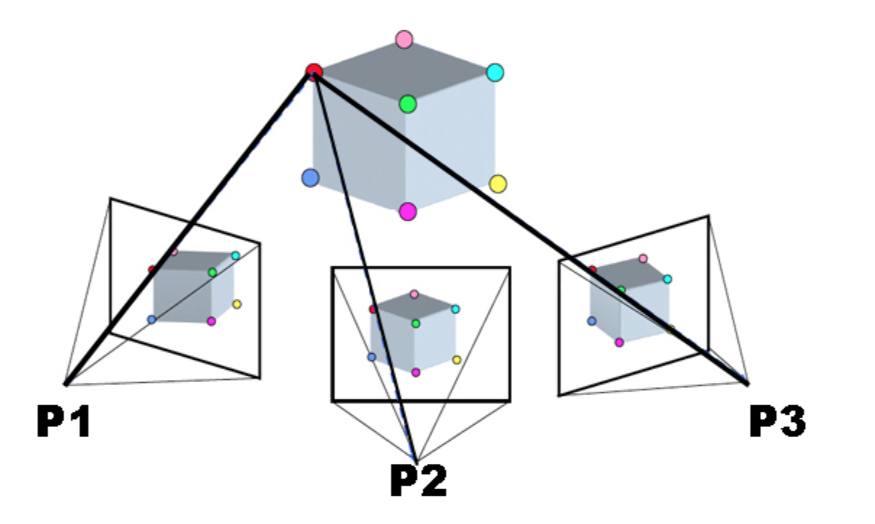
Algorithm
https://spaceport.tv/wp-content/uploads/2022/11/spaceport-blog2.png

Slide 5
Algorithm
From a set of images find its correspondences/similar points.
With these similarities find relative poses/positions between of the cameras used to take these images.
Determine these points in 3D space using triangulation and plot it.

Slide 6
Pipeline

Slide 7
Pipeline Diagram
Feature extraction
Geometry estimation
Image extraction and process
Feature Matching
Stereo Image Rectification
& 3D projection
Camera Calibration
Dense Reconstruction
Presentation Title

Slide 8
Pipeline – Image extraction
Take a photo of what’s is considered the center or reference scene
Take photos moving to the left and right respectively departing from the center.

Slide 9
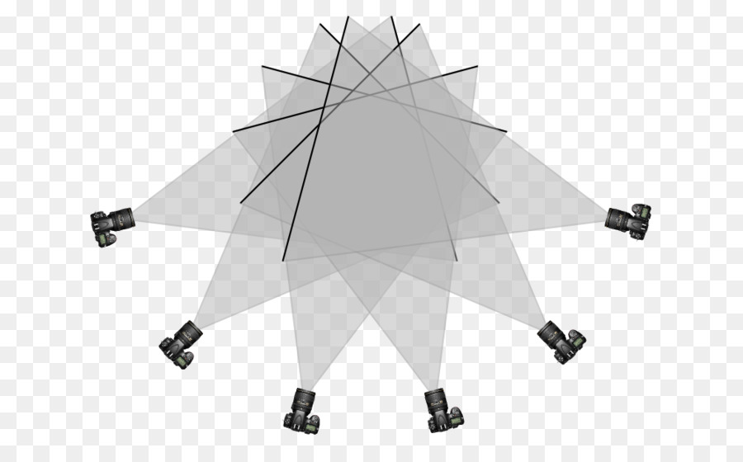
Pipeline – Image extraction
It’s like taking a panoramic view the approach
https://www.cleanpng.com/png-structure-from-motion-geometry-angle-photography-2378347/

Slide 10
Pipeline – Image Processing
Upload photos and organize accordingly
Dow sampling (Images are too big) – tradeoff lose of complexity.
Of course, save them!
* They will be undistorted sooner or later.

Slide 11
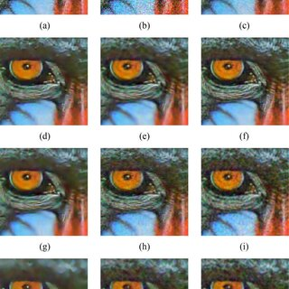
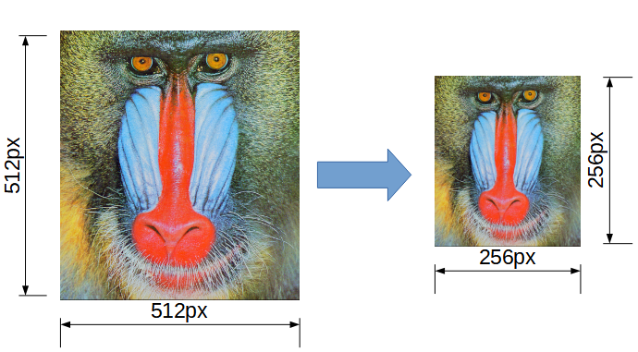
Pipeline – Image Processing

Slide 12
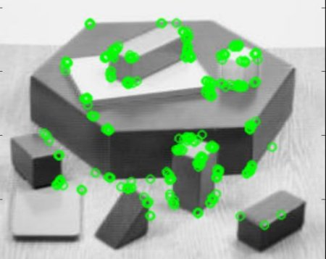
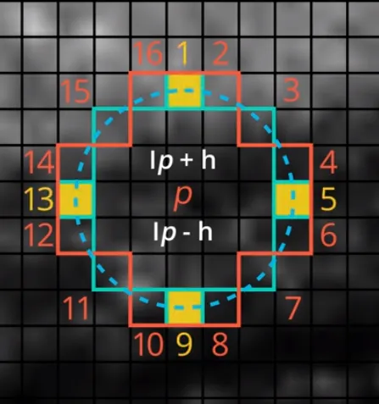
PipeLine – Feature Extraction
Use of ORB Detector (Oriented FAST and Rotated BRIEF)
https://miro.medium.com/v2/resize:fit:640/format:webp/1*sMlXGwLPQU60UldEiY-Mow.png
https://docs.opencv.org/4.x/orb_kp.jpg

Slide 13
PipeLine – Feature Extraction
ORB DETECTOR = FAST + BRIEF Is an efficient alternative to SIFT or SURF
Done by OpenCV labs , not patented as SIFT!
Less computational cost and better matching performance
Solve FAST problem to compute orientation and BRIEF with rotation.

Slide 14
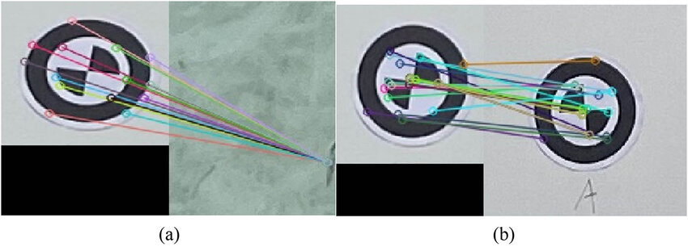
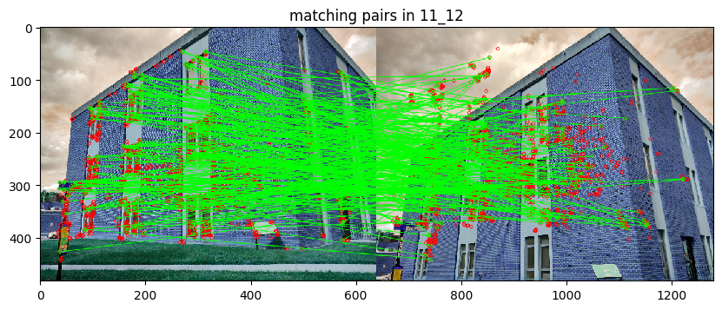
Pipeline – Feature Matching
Use of FLANN feature matching (Fast Library for Approximate Nearest Neighbors)
https://www.researchgate.net/publication/380067491/figure/fig3/AS:11431281238569273@1713981700689/FLANN-feature-matching-a-error-match-point-and-b-match-the-points-correctly.jpg

Slide 15
PipeLine – Feature Matching
FLANN:
Optimized for fast nearest neighbor search in large datasets and for high dimensional features.
Use of recursively traverse of kd-trees - Nearest Neighbors Approach.
Run faster than brute force matcher algorithms

Slide 16
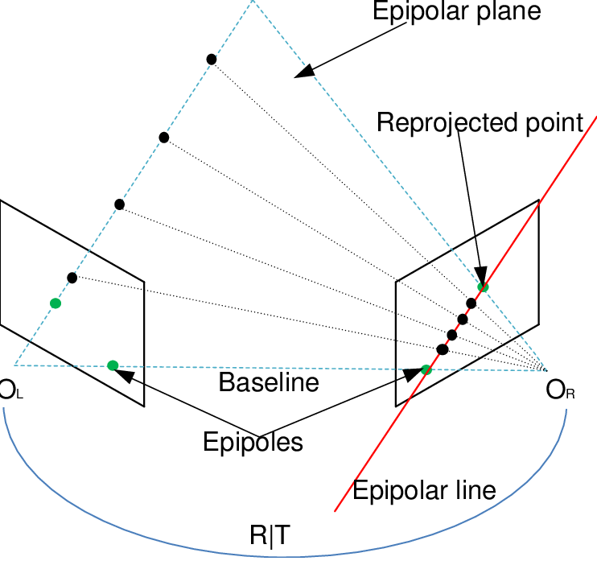
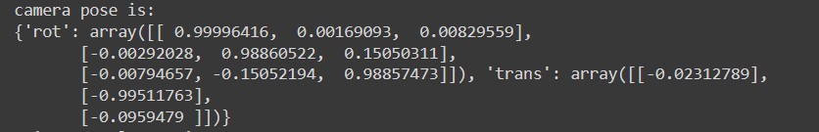
Pipeline – Geometry pose estimation
Use of the concepts of epipolar geometry
https://www.researchgate.net/profile/Reza-Hoseinnezhad/publication/284136264/figure/fig5/AS:668708238274566@1536443876528/llustration-of-the-epipolar-geometry-The-two-cameras-are-indicated-by-their-centres-O-L.png

Slide 17
PipeLine – Geometry pose estimation
Purpose: Obtain the extrinsic matrix between images to obtain the projection matrix.
Calibration of camera is necessary → get Intrinsic matrix-Camera matrix.
1.1 Photos were taken with the same camera so it’s the same for all

Slide 18
PipeLine – Geometry pose estimation
Purpose: Obtain the extrinsic matrix between images to obtain the projection matrix.
Calibration of camera is necessary → get Intrinsic matrix-Camera matrix.
1.1 Photos were taken with the same camera so it’s the same for all

Slide 19
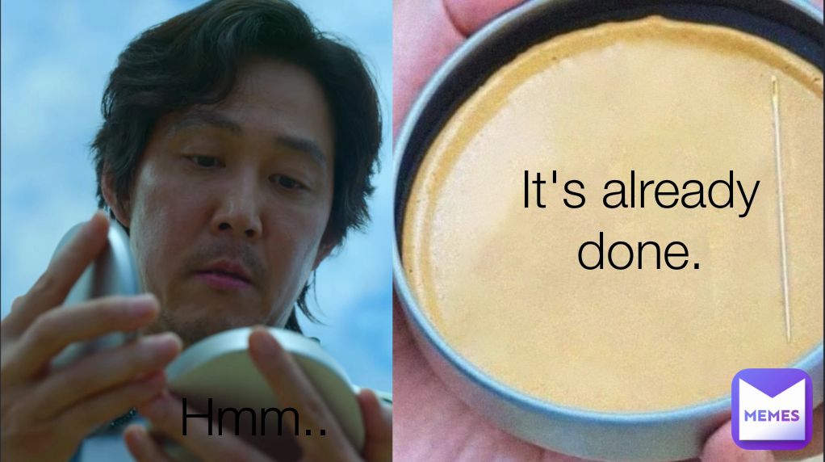
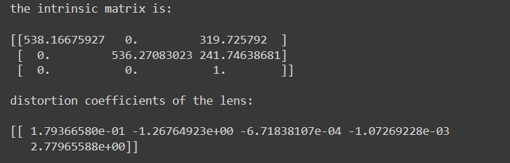
Pipeline – Geometry pose estimation
Thanks Project3!!
Of course it’s the handy smartphone camera

Slide 20
PipeLine – Geometry pose estimation
Purpose: Obtain the essential matrix between images to obtain the projection matrix.
Calibration of camera is necessary → get Intrinsic matrix-Camera matrix.
1.1 Photos were taken with the same camera so it’s the same for all

Slide 21
PipeLine – Geometry pose estimation
With essential matrix comes also the extrinsic matrix.
At the end is the computation the relative orientation and translation between a pair of images.
But with respect to which world coordinate system? It is important to have a reference, these matrices will come handy after.

Slide 22
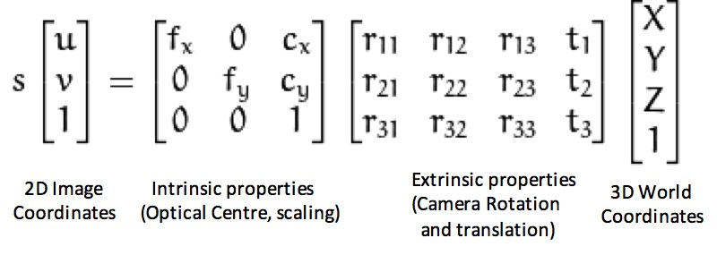
PipeLine – Geometry pose estimation

Slide 23
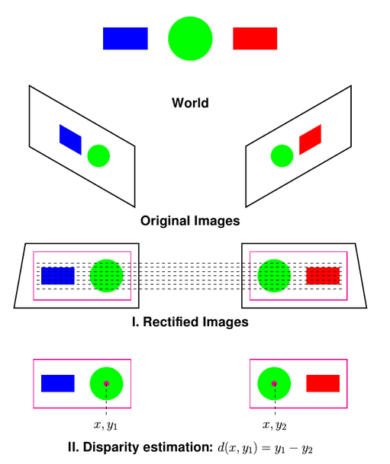
Pipeline – Stereo Image rectifaction

Slide 24
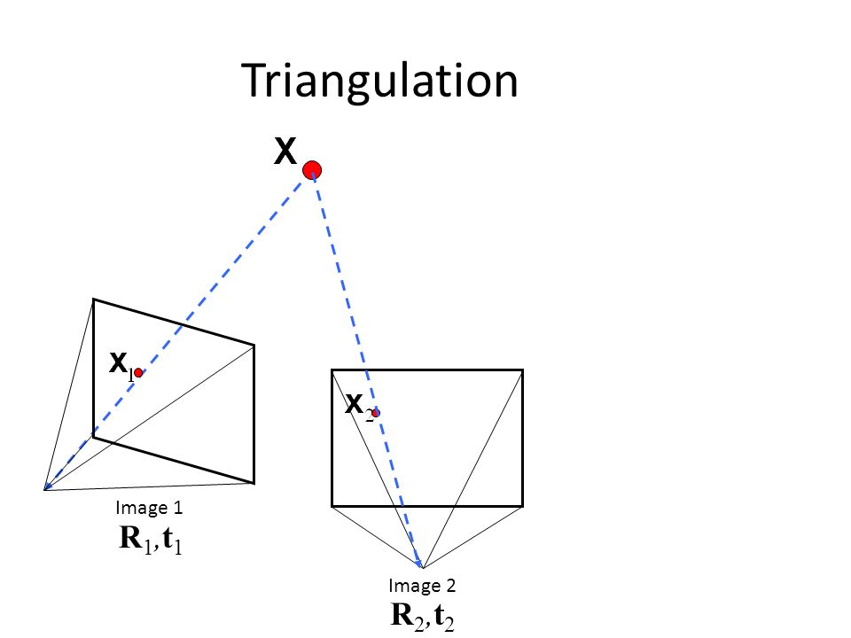
Pipeline – Stereo Image rectifaction
https://slideplayer.com/slide/9177510/

Slide 25
PipeLine – Stereo Image rectifaction
1.Undistort-Rectify images with camera calibration parameters.
2. Using the previous intrinsic and Rot/trans matrix obtained generate disparity maps for each pair of images.

Slide 26
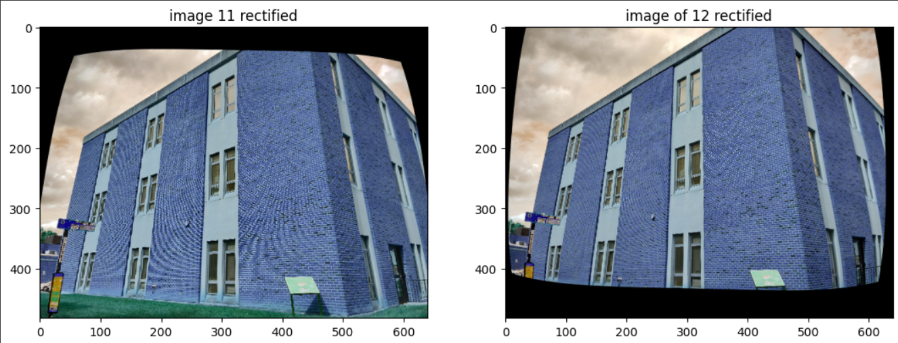
Pipeline – Stereo Image rectifaction

Slide 27
PipeLine – Stereo Image rectifaction
3. Disparity maps can be used to compute 3D points from homogenous coordinates with respect to these coordinate system. Triangulation.
4. These points after transform to the original 3D points system with the relation of poses between cameras.

Slide 28
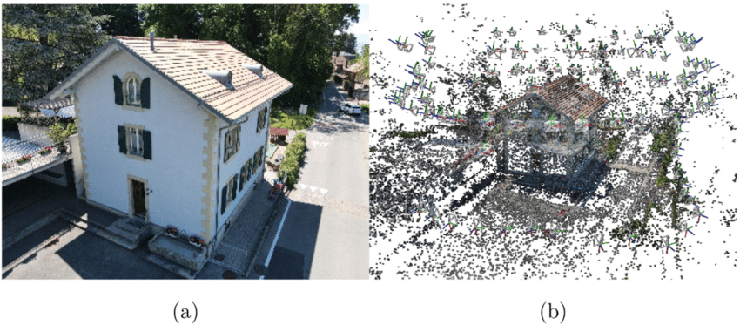
Pipeline – Dense Reconstruction

Slide 29
PipeLine – Dense Reconstruction
Use of open3D to visualization, pass 3D points and colors of them (using undistorted images)
More images in different perspectives will give better reconstruction of the entire object….

Slide 30

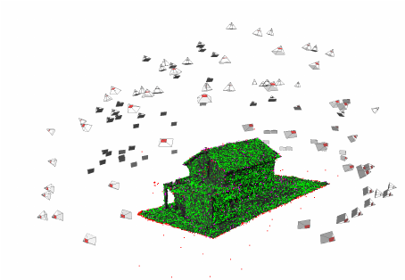
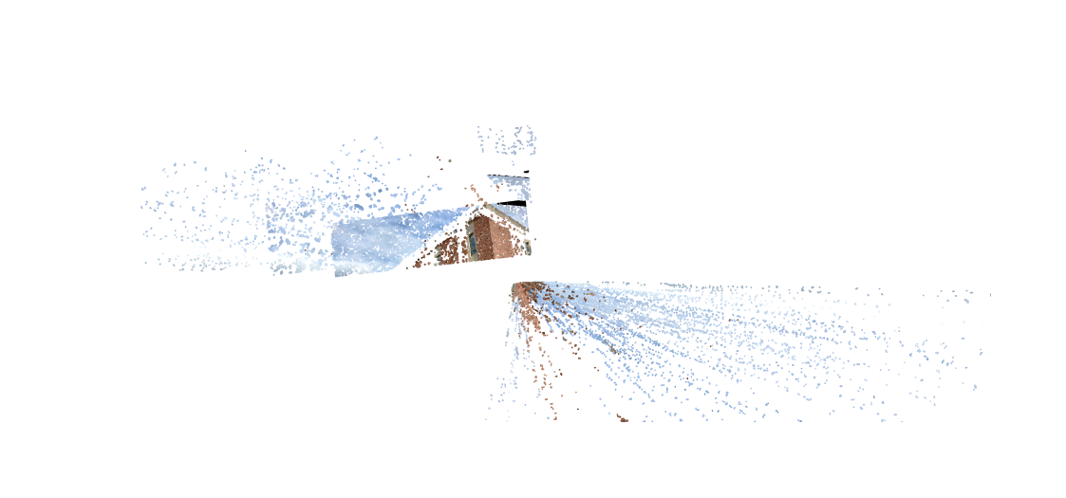
Results
https://www.researchgate.net/publication/235332439/figure/fig3/AS:299839091953670@1448498618982/SfM-result-of-the-house-scene-Our-approach-selects-106-camera-positions-gray-out-of.png

Slide 31
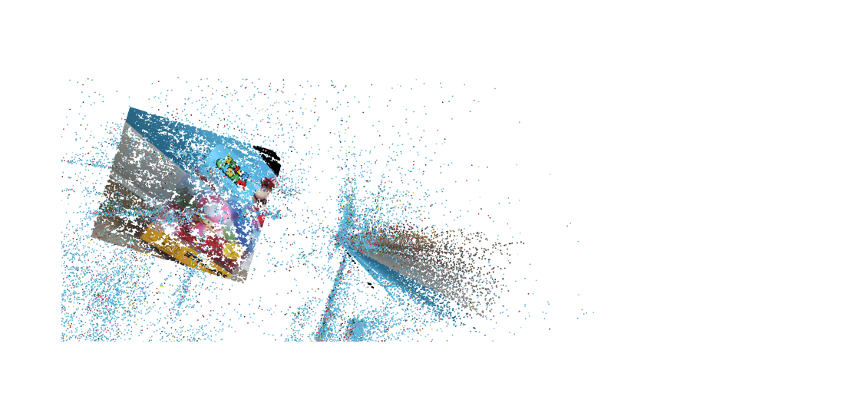
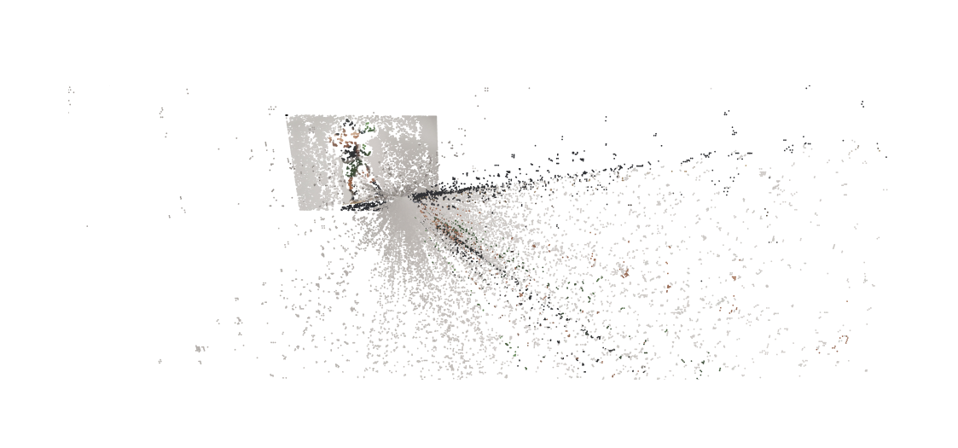
Results- Examples dense reconstruction

Slide 32
Results- Examples dense reconstruction
Use of open3D to visualization, pass 3D points and colors of them (using undistorted images)
More images in different perspectives will give better reconstruction of the entire object….

Slide 33
Results- Examples dense reconstruction
Use of open3D to visualization, pass 3D points and colors of them (using undistorted images)
More images in different perspectives will give better reconstruction of the entire object….

Slide 34
Results- Challenges Faced
Huge quantity of information and at the end 3D points can be generated. That is a problem for processing → Ask for High Performance Computing ?
Tuning of parameters can affect substantially a good result or not. Stereo disparity map is frustrating.
Some photos become noisy after undistortion .
A lot of outliers!

Slide 35
Results- Challenges Faced
Handling the multiple view stereo problem is challenging dense correspondence is not ideal by far.
Are we really taking into account an effect for stereo rectification when converting coordinates to reference?

Slide 36
Improvements
Tunning of parameters via deep learning or any machine learning algorithm as it seems for every pair of image you would need its own parametrization, especially for disparity.
Implementation of a bundle adjustment technique for refine the visual reconstruction e.g too much points into infinity.

Slide 37
Future Work
Use in application with vSLAM Techniques
3-D scanning
Augmented reality

Slide 38
Bibliography
[1] MathWorks. (n.d.). MathWorks. Retrieved from Structure from Motion from Multiple Views: https://www.mathworks.com/help/vision/ug/structure-from-motion-from-multiple-views.html
[2] OpenCV. (n.d.). Camera Calibration and 3D Reconstruction. Retrieved from https://docs.opencv.org/4.x/d9/d0c/group__calib3d.html
[3] Singh, C. D. (n.d.). Structure From Motion. Retrieved from Computer Vision: https://cmsc426.github.io/sfm/

